Slide 1



National Institute of Fashion Technology, Jodhpur
Managerial Economics
Economic Structure and Macroeconomic Impact of SpaceEase Organisers (Hypothetical Brand)
Discipline: Faculty of Management Studies
Semester: 1
Batch: 2025-27
Course Faculty: Prof. Dr. Mahendra Dahiya
By: Nandini Laddha & Pooja Kumari

Slide 2



HOME
ABOUT
CONTENT
OTHERS
SpaceEase Organisers
Tagline: Sustainable Living Solution
SpaceEase Organisers Pvt. Ltd. is a design-driven, sustainable brand specialising in modular home and office organisers that redefine the way people use space. Based in Jodhpur, Rajasthan, the company merges functionality with aesthetic design to help urban consumers live smarter in compact environments.
At its core, SpaceEase Organisers believes that “Space is luxury - and design makes it accessible.” The brand addresses the growing problem of limited living space in Indian cities by offering affordable, eco-friendly, and customisable solutions that enhance both utility and comfort.

Slide 3

HOME
ABOUT
CONTENT
OTHERS
📦Industry Overview
Urbanisation and small homes are driving demand for space-saving modular furniture.
Millennials and professionals prefer foldable, multifunctional, easy-to-move organisers.
E-commerce growth is making modular furniture more accessible and affordable.
Sustainability awareness is increasing demand for eco-friendly materials.
The market is competitive and fragmented, with both big brands and local carpenters.
WFH and hybrid lifestyles continue to boost demand for study tables and workstations.
Overall, the industry shows strong growth potential for innovative brands like SpaceEase.

Slide 4


Concept & Ideation
🎯Core Idea
Create modular, foldable, sustainable furniture for compact Indian homes.
Solve urban issues: limited space, rising population, sustainability needs.
Brand philosophy: “Designing Space. Defining Comfort.”
💡 Unique Value Proposition (UVP)
Sustainable, affordable, modular furniture tailored for small spaces.
USP: Eco-luxury + functionality for modern compact living.
🧩 Market Gap
Large brands (IKEA, Godrej) offer modular furniture but not compact, portable.
SpaceEase fills this eco-functional niche in the market.

Slide 5

Model type
Element | SpaceEase Approach
Business Type | Private Limited Company
Model | Direct-to-Consumer (D2C) via e-commerce + selective retail
Revenue Streams | Product sales (foldable furniture, organisers), custom designs, B2B bulk orders
Pricing Strategy | ₹2,000–₹15,000
Production Model | Own small-scale manufacturing + local supplier network
Distribution | Website, Amazon, Flipkart, furniture marketplaces, and small urban experience stores

Slide 6

Segmentation, Targeting & Positioning
🏙️ Target Market
Primary: Urban professionals, students, and renters aged 20–40.
Secondary: Small offices, hostels, and co-living spaces.
Geography: Tier-1 and Tier-2 cities — Delhi, Mumbai, Pune, Bengaluru, Jaipur
📊 Demand Analysis
Increasing work-from-home setups → higher need for foldable, space-efficient desks.
India’s home furniture market is growing at 11–13% CAGR (2024–2029), with modular furniture dominating.
Consumers are shifting toward eco-friendly and affordable design.

Slide 7
Product Line
Foldable Table
3. Foldable Office Workstation
Steel frame + prelaminated engineered wood top.
Folds compactly for easy storage; portable and pre-assembled.
Serves as study desk, office table, or dining table.
Load capacity: up to 70 kg.
Price Range: ₹4,500 – ₹7,000
Steel legs with collapsible design for remote or hybrid workers.
Adjustable height and cable management.
Price Range: ₹8,000 – ₹12,000.
2. Wall-Mounted Shelving Units
4. Modular & Shoe Organiser
Compact stacked units using prelaminated panels and steel frame dividers.
Easy to clean, highly durable, perfect for city apartments.
Price Range: ₹3,000 – ₹9,000.
Modular units with concealed steel brackets.
Matte wood finishes with modern aesthetics.
Ideal for books, décor, or workspace organisation.
Price Range: ₹2,500 – ₹6,000.

Slide 8

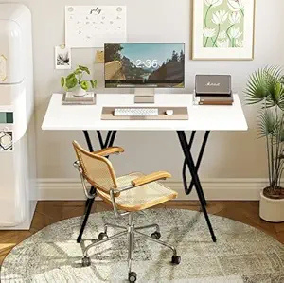
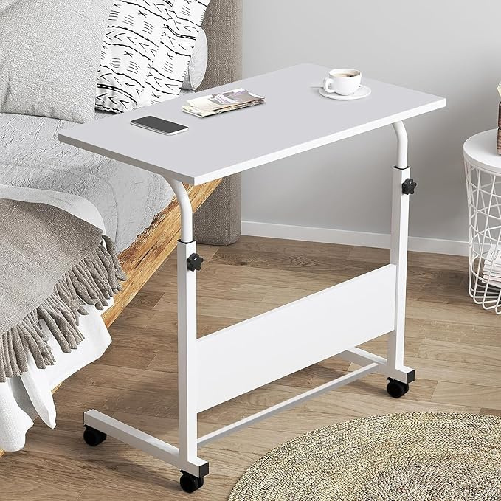
Visual Elements

Slide 9
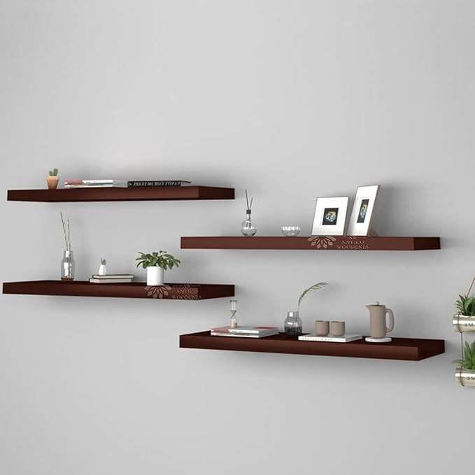
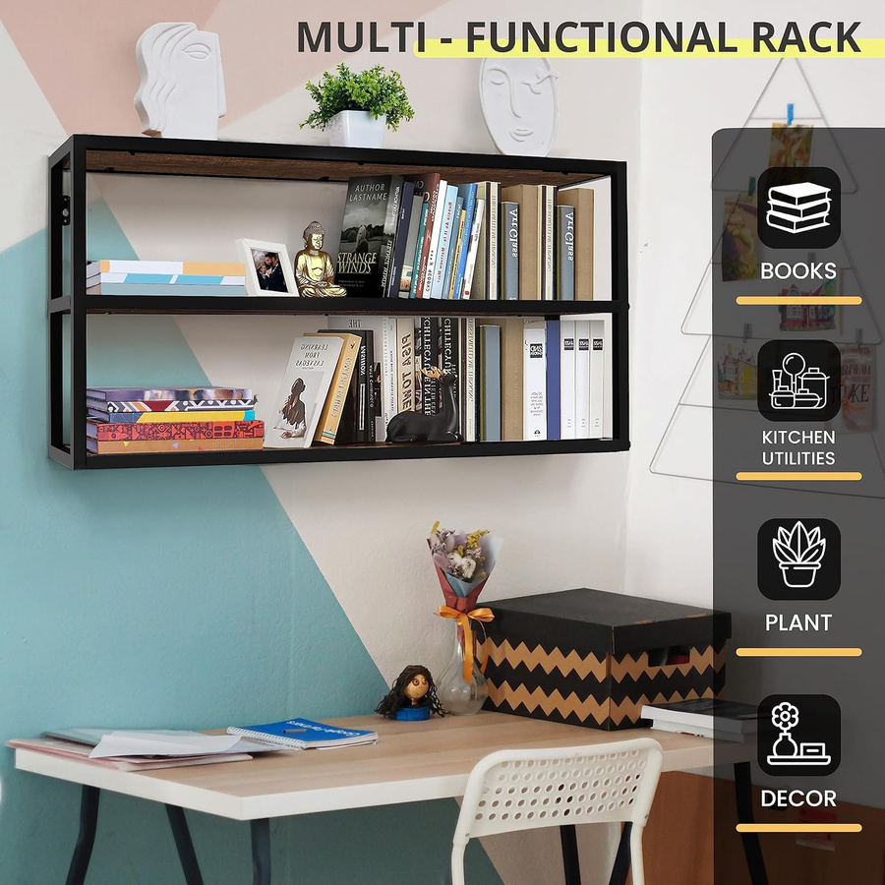
Visual Elements

Slide 10


Material Sustainability
Area | Practice
Material | Engineered wood, which uses fewer trees recyclable metals and plastic
Material Certification | Use of E1/E0 grade boards with low formaldehyde emission.
Durability | Long product life = reduced waste.
Powder Coating | Solvent-free, recyclable, minimal VOC
Energy Efficiency | Solar energy used in cutting and coating units.
Packaging | Corrugated cardboard and recyclable paper filling (no plastic wrap).

Slide 11


Competitor Analysis
Brand | Material | Target | Design | Price Range
Godrej Interio | MDF, Metal | Families | Traditional | ₹10,000–₹1,50,000
IKEA India | Fibreboard, Metal | Urban | Scandinavian | ₹1,999–₹80,000
Woodenstreet | Solid Wood | Online Buyers | Modern Rustic | ₹20,000–₹70,000

Slide 12

Micro Economic Aspect
1. Factors of Production
Land: The production unit is set up in Jodhpur, benefiting from affordable industrial land and government subsidies under the Startup Rajasthan policy.
Labour: Skilled artisans, carpenters, and semi-skilled workers are employed for manufacturing and finishing processes.
Capital: Initial investment is financed through startup funding and loans under the Mudra Yojana scheme.
Entrepreneurship: The founders combine design knowledge and business expertise to innovate in the modular furniture market.

Slide 13

Micro Economic Aspect
2. Cost and Revenue Model
The company operates on a low-cost model by sourcing local materials and selling directly online, eliminating middlemen.
Fixed Costs: Factory rent, equipment, software, and machinery.
Variable Costs: Raw materials, labour wages, transportation, and packaging.
Revenue: Generated from online sales, custom design orders, and bulk sales to corporate offices.

Slide 14


Pricing Strategy
Value-Based Pricing
Price is set based on the value perceived by customers (design, space-saving, eco-friendly), not just production cost. Helps justify slightly premium pricing vs. local carpenters.
Competitive Pricing
Price products close to or slightly below competitors (IKEA, WoodenStreet) to attract price-sensitive Indian customers. Helps gain market share quickly.
Bundled Pricing
Offer sets like organiser + drawer unit or 2+1 combos at a discounted price. Encourages larger purchases and increases average order value.
Seasonal Pricing
Offer discounts during peak sales seasons like: Diwali, Republic Day, etc

Slide 15
Price Elasticity of Demand Table
Product | Price Range | Type of Product | Price Elasticity of Demand (Hypothetical) | Elasticity Category
Foldable Multipurpose Study Table (Flagship) | ₹4,500 – ₹7,000 | Semi-essential, multifunctional furniture | –1.4 to –1.8 | Elastic
Wall-Mounted Shelving Units | ₹2,500 – ₹6,000 | Decorative + functional | –1.6 to –2.0 | Highly Elastic
Foldable Office Workstation | ₹8,000 – ₹12,000 | Premium WFH product | 0.8 to –1.1 | Unitary to Slightly Elastic
Modular Shoe & Wardrobe Organisers | ₹3,000 – ₹9,000 | Functional, space-saving essential | –1.0 to –1.3 | Moderately Elastic

Slide 16
SWOT
Strengths
Design-driven modular products for compact homes
Eco-friendly materials enhance brand value
Cost advantage due to Jodhpur’s artisan ecosystem
Weakness
Limited brand visibility vs IKEA/Godrej
Smaller scale restricts automation and expansion
Heavy dependence on skilled manual labour
Opportunities
Growing demand for space saving organisers in urban India
Rising preference for sustainable home products
Potential to expand via e-commerce, offline stores
Threats
Strong competition from large furniture brands
Price-sensitive consumers shifting to cheaper alternatives
Raw material and logistics cost fluctuations

Slide 17


Macro Economic Aspect
Political
Economic
Social
• MSME support under Make in India
• Government push for sustainable products
• Improved logistics & GST system
• Urbanisation increasing demand for compact furniture
• Rising middle-class incomes
• Raw material price fluctuations
• Growth in e-commerce furniture sales
• Preference for minimalistic, organised homes
• WFH increasing need for workstations
• Growing interest in sustainable living
• Younger consumers prefer portable/foldable designs

Slide 18
Macro Economic Aspect
Technological
Environmental
Legal
• Advancements in CNC machining & modular design
• Growth of e-commerce platforms
• CAD tools improving design efficiency
• Improved logistics tracking technology
• Increasing demand for eco-friendly materials
• Waste management and recycling norms
• Climate affecting raw material supply
• Labour safety & fair wage regulations
• Consumer protection laws
• Environmental compliance standards
• GST and tax rules

Slide 19



Thank You

